Slide 1
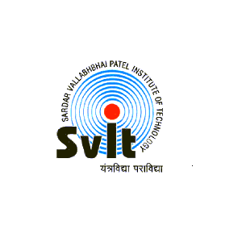
current trend in internet banking
Name: vatsal changela
class:SY-IT, 1
En.roll- 160410116020

Slide 2
What is internet banking?
Internet banking involves consumers using the internet to access their bank account and to undertake transactions
At the basic level, internet banking can mean the setting up of a web page by a bank to give information about its product and service.
At an advance level, it involves provision of facilities such as accessing accounts
Funds transfer
Buying financial products or services online.
This is called “transactional” online banking.

Slide 3
There are two ways to offer internet banking.
An existing bank with physical offices can establish a web site and offer internet banking in addition to its traditional delivery channels.
Second, a bank may be established as a “branch less, internet only, or virtual bank” without any physical branch.

Slide 4
Banking services through internet.
Levels of banking service.
Structure of banking services

Slide 5
Levels of banking service
The basic level service use the banks website which disseminate information on different products and services offered to customers and members of public in general. It may receive and reply to customers queries through e-mail.
In the next level are simple transactional website which allow customers to submit their instruction, application for different services, queries on their account balance, etc.
but do not permit any fund-based transaction on their accounts.

Slide 6
The third level of internet banking service are offered by fully transactional website which allow the customers to operate on their accounts for transfer of funds, payment and sale of securities, etc.
Most of the banks providing internet banking products and service offer, to a large extent, an identical and standard package of banking service and transactional capablities.

Slide 7
Structure of banking services
Basic level of internet banking services:
Customers account inquiry
Funds transfer
Electronic bill payment

Slide 8
Second or premium level internet banking services
It includes basic service plus one or more additional service such as
Brokerage
Cash management
Credit and debit cards
Credit application
Custommers correspondence
Demat holdings
E-shopping
investments
Foreign exchange trading
Insurance
Online trading
Opening accounts
Requests and intimations
Tax services
Standing instruction
Asset managemet services

Slide 9
Traditional banking vs. internet banking
In traditional banking, the customers has to visit the branch of the bank in person to perform the basic banking operation viz, account enquiry, funds transfer, cash withdrawing etc.
E-banking enables the customers to perform the basic banking transactions by sitting at their homes or at office through a desktop or laptop round the clock globally through electronic media.

Slide 10
Advantages of internet banking
Round the clock banking
E-banking facilitates performing basic banking transaction by customers round the clock globally. In fact there is no restricted office hours for E-banking.
ii. Convenient banking
customers can perform basic banking transactions by simply sitting at their office or at home through PC or laptop. No personal visit to the branch is required for routine basic transaction.

Slide 11
profitable banking
The increased speed of response to customer requirements, can enhance customer satisfaction and consequently can lead to higher profits as a result of handling more number of customer accounts.
Quality banking
internet banking allows the possibility of improved quality and an enlarged range of service being made available to customers.
Speed banking
the increased speed of response to customers requirements will lead to greater customer satisfaction and handling a large number of transaction at a lesser time.

Slide 12
Service Banking
Banks can also offer many cash management products. Instant credit, one day credit, immediate payment of utility bills, instant transfer fund etc.

Slide 13
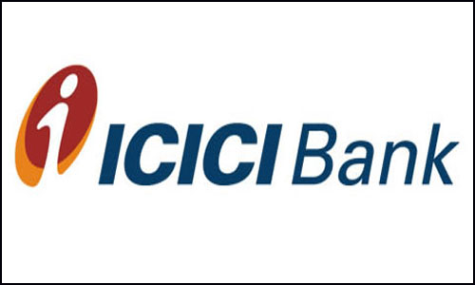


Slide 14
Service provided by icici bank through internet
Online bill payment
Fund transfer
Shopping
Ticket booking
Prepaid mobile recharge
Share trading
charity

Slide 15
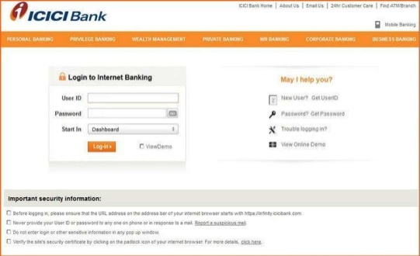

Slide 16
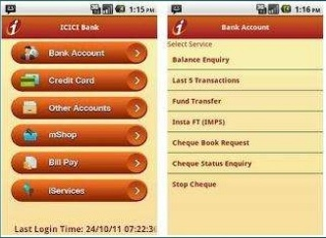

Slide 17
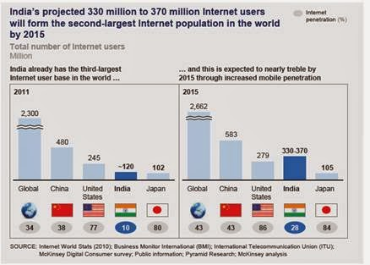
According to a report by boston consulting group (BCG), in india, out of 1.2 billion only 200 million people having bank accounts, which is only 17% of indian.
According to mckinsey report (2011) (with 120 million internet) india had third largest internet in the world after china and us and india had targeted for 330-370 million internet users in 2015 which will make it second largest internet. In same report, it is mention that in made pasitive improvement in e-commerce.
Further it is reported that 7% of account holders in the country are using the internet for banking transactions while branch banking has fallen by a full 15 percantage points.

Slide 18
according to comScore, 423.5 million people accessed online banking sites
worldwide during April 2012, reaching
28.7 percent of the internet audience.
45 percent of the internet audience in
North America accessed bank sites
When it comes to digital banking in Asia,
the Mc Kinsey & company survey said,
“India leads growth in Asia in mobile and
Internet usage for banking.”

Slide 19
conclusion
All the major banks in India are trying to promote online transaction in the country including the rural parts of the country.
Being a huge fan of e-governance, indian prime minister – Mr. Narendra Modi has initiated a project estimated
At INR 20,000 crores to build a broadband highway connecting 2.5lakh panchayats across the country. Once fully set up, this infrastructure would help the rural india connect with the urban India while boosting the rate of online transaction and internet banking in the country.

Slide 20
THANK YOU

